Slide 1
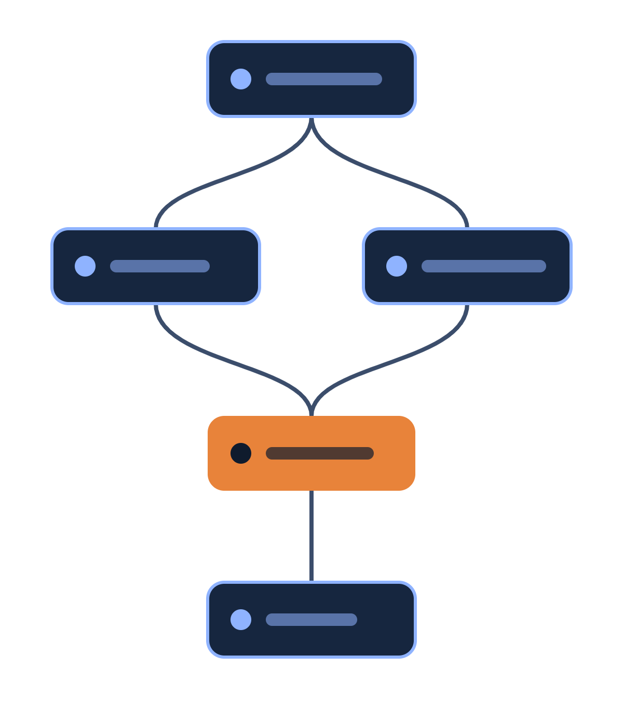
Microsoft Agent Framework for the enterprise
AI AGENTS IN THE ENTERPRISE
What it is, why it matters to large organizations, and how the Workflow Builder puts it to work.
November 2026
Notes:
Three parts: why agents in the enterprise need a framework, what Microsoft Agent Framework provides, and how our Workflow Builder, built on that framework, makes it usable by more people. The graph on the right is the shape of every workflow we will look at: steps, branches, and an approval in orange.

Slide 2



The enterprise challenge
WHY A FRAMEWORK
An AI agent is quick to demonstrate. Putting agents inside real business processes raises three harder questions.
Control
Trust
Continuity
Who decides the next step: the model, or the process owner?
Who approved the change, and can we show what happened?
What if a run takes days, or the server restarts halfway?
An agent framework answers these questions once, for every team that builds on it.
Microsoft Agent Framework for the enterprise
2
Notes:
Most teams have seen an agent demo. The hard part starts when the agent touches real systems. Three questions come up every time: control over what happens next, trust in who approved what, and continuity when a process runs longer than one request. Without a framework each team answers them differently.

Slide 3

What Microsoft Agent Framework is
THE FRAMEWORK
Semantic Kernel
Enterprise features: state, type safety, middleware, telemetry
THE SUCCESSOR TO BOTH
Microsoft Agent Framework
Combines the two and adds graph-based workflows, for explicit control over how agents work together.
AutoGen
Simple abstractions for single- and multi-agent patterns
Version 1.0
.NET and Python
Open source
Generally available since April 2026
Go is in public preview
Built by the Semantic Kernel and AutoGen teams
Source: Microsoft Learn, Agent Framework overview
3
Notes:
Microsoft had two agent projects. Semantic Kernel brought the enterprise features; AutoGen brought simple multi-agent patterns. Agent Framework is the direct successor to both, made by the same teams. Version 1.0 became generally available in April 2026 for .NET and Python; Go is in public preview. Microsoft publishes migration guides from both older projects.

Slide 4




Four building blocks
THE FRAMEWORK
Agents
Harness Agent
Use a model to handle a request, call tools and MCP servers, and answer. Works with many model providers.
A ready-made agent for long, multi-step tasks: planning, memory, file access and tool approval built in.
Workflows
Integrations
Functional and graph-based flows that connect agents and functions along explicit paths you define.
Connections to model providers, agent services, tools, memory, middleware, evaluation and UI frameworks.
Source: Microsoft Learn, Agent Framework overview
4
Notes:
The framework has four areas. Agents are single assistants that use a model and tools. The Harness Agent is an opinionated, batteries-included agent for long tasks. Workflows, highlighted here, are the part this deck concentrates on: they connect agents and plain functions along paths that people define. Integrations cover model providers such as Microsoft Foundry, Azure OpenAI, OpenAI, Anthropic and Ollama, plus tools and memory.

Slide 5


Agents and workflows
THE FRAMEWORK
Use an agent when…
Use a workflow when…
The task is open-ended or conversational
The process has well-defined steps
It needs autonomous tool use and planning
You need explicit control over the order of execution
One model call, possibly with tools, is enough
Several agents or functions must coordinate
Microsoft’s own advice: if a plain function can handle the task, write the function instead of using an AI agent.
Source: Microsoft Learn, Agent Framework overview
5
Notes:
This is Microsoft’s own guidance. Agents suit open-ended work where the model plans for itself. Workflows suit processes with known steps and an order that must be respected. Most enterprise processes, such as approvals, provisioning and month-end tasks, look like the right-hand column. And where ordinary code can do the job, ordinary code is still the better choice.

Slide 6

Anatomy of a workflow
THE FRAMEWORK
A workflow is a graph: executors do the work and edges decide what runs next. The example is Weekend Saver, six steps in a fixed order.
Step 1
Step 2
Step 3
Step 4
Step 5
Step 6
Load targets
Resolve state
Approval by a person
Apply
Verify
Report
Executors
Edges
Human in the loop
Checkpoints
Each box is a step: plain code or an AI agent.
Arrows pass typed messages and can branch on a condition.
The run pauses at the approval step and resumes when a person answers.
Progress can be saved and restored, so a long run can be resumed.
Microsoft Agent Framework for the enterprise
6
Notes:
A workflow is a graph. The boxes are executors: each is either ordinary code or an AI agent. The arrows are edges; they carry typed messages and can branch. Two capabilities matter most to an enterprise. Human in the loop: the run stops at the orange approval step until a person says yes or no. Checkpoints: the framework can save and restore a workflow’s progress. The six steps shown are the real steps of the Weekend Saver workflow we come to later.

Slide 7






What enterprises gain
THE FRAMEWORK
Explicit control
Human approval
Durable runs
Process owners define the path. The model works inside the steps it is given.
A run can pause for a person’s decision and continue afterwards.
Checkpoints save progress, so a long process can resume after an interruption.
Observability
Governance hooks
Freedom of choice
Spans, metrics and events show what each step did, using OpenTelemetry.
Middleware intercepts agent actions: one place for policy checks and logging.
Foundry, Azure OpenAI, OpenAI, Anthropic or Ollama models; tools through MCP.
Control, Trust and Continuity, answered by the framework instead of by each project.
Microsoft Agent Framework for the enterprise
7
Notes:
Back to the three questions. Control: explicit paths and middleware. Trust: human approval and observability, so there is a record of what each step did. Continuity: checkpoints. On top of that the framework does not tie the organization to one model: it works with Microsoft Foundry, Azure OpenAI, OpenAI, Anthropic and Ollama, and tools connect through the Model Context Protocol.

Slide 8
From a framework for developers to a tool the whole team can use.
FROM FRAMEWORK TO TOOL
Agent Framework is used by writing .NET or Python. The Workflow Builder sits on top of it and starts from a sentence.
Notes:
Everything so far needs a developer. That is the gap the Workflow Builder closes. It is our own application built on Microsoft Agent Framework; it is not a Microsoft product. The people who know a process best are often not the people who write Python, and the builder lets them start.

Slide 9
The Workflow Builder
THE BUILDER
A web app on Microsoft Agent Framework: describe a process, get a working definition.
Step 1
Step 2
Step 3
Step 4
Step 5
Describe
Generate
Visualize
Test
Refine
Write the process in plain words
A YAML definition and Agent Framework code
See steps and paths as a graph
Run it step by step in the playground
Change it with a follow-up message
Checked before it is saved
Your models, your sign-in
The YAML schema, the Python code and the graph’s connections are validated.
Uses your Azure OpenAI deployment, including one in Microsoft Foundry.
Microsoft Agent Framework for the enterprise
9
Notes:
The builder is a chat on the left and a graph on the right. You describe the process, for example: “when an invoice arrives, extract the fields, check them against the order, and ask a manager to approve anything over the limit”. The builder writes a workflow definition and the matching Agent Framework code, draws the graph, and lets you run it in a playground. Every follow-up message edits the same workflow. Each AI step is also saved as an agent you can open on the Agents page. Models come from your own Azure OpenAI deployment, signed in through the Azure CLI or a key.

Slide 10
How the builder helps enterprises
THE BUILDER
Speed
People who know the process can draft it in minutes, without learning the framework first.
Shared picture
Business owners and engineers look at the same graph and agree on the steps before anything is built.
Standard output
The result is plain YAML and Agent Framework code: files a team can review, version and take over.
Safe trials
The playground simulates a run, so a draft can be tried without touching real systems.
Microsoft Agent Framework for the enterprise
10
Notes:
Four benefits. Speed: the first draft no longer waits for engineering time. Shared picture: the graph is something a process owner and an engineer can both read, which removes a lot of misunderstanding. Standard output: the builder does not lock anything in; it writes ordinary files in the framework’s own format, so engineers can continue from them. Safe trials: the playground walks through the steps with the model playing each one, and changes nothing outside.

Slide 11
Weekend Saver: a real workflow
PROOF
The builder includes one workflow that is executed for real. It switches chosen Azure resources off for the weekend and back on afterwards.
What it manages
A person approves the plan before anything changes
Virtual machines and scale sets
AKS clusters
App Service apps
Application Gateways
PostgreSQL and MySQL flexible servers
AI steps can comment on a run or stop a switch-off; they can never keep resources off
Every change is recorded for each resource
Dry run, weekly schedule and a protected page
Estimated saving
[€__ per month]
across [__ resources]
Microsoft Agent Framework for the enterprise
11
Notes:
Weekend Saver is the proof that this is more than drawing. It is a real Microsoft Agent Framework workflow with the six steps we saw earlier. It acts with the signed-in person’s own Azure permissions. It can be customized in plain words: add an AI step that summarizes a run, or an AI gate that stops a switch-off, for example in a public-holiday week. The six built-in steps cannot be removed, and a model problem can never leave resources switched off. Fill in the saving figure and the number of resources from your own subscription before presenting.

Slide 12

Status and next steps
WHERE WE ARE
Today
Proposed next steps
A proof of concept, run locally by one person
Sign-in and roles with Microsoft Entra ID
Only Weekend Saver runs for real; other workflows are simulated
Run every workflow for real, with approvals and checkpoints
Models come from one Azure OpenAI deployment
A shared library of agents, reused across workflows
Each workflow keeps its own copy of its AI steps
Telemetry in your monitoring platform and a hosted deployment
Microsoft Agent Framework for the enterprise
12
Notes:
An honest picture. Today the builder is a proof of concept that one person runs on their own machine; its general endpoints have no sign-in. Workflows you create are simulated in the playground: the model plays each step. Weekend Saver is the exception and really runs. The right-hand column is a proposal, not a commitment: the framework already offers approvals, checkpoints and telemetry, so most of the work is wiring the builder to them and adding identity.

Slide 13
Start with one process
HOW TO BEGIN
1
2
3
Pick
Build
Measure
A repeatable process with clear steps and one approval.
Describe it in the Workflow Builder and review the graph together.
Run it, record the outcome, and decide what to automate next.
Notes:
The ask is small. Choose one process that repeats, has clear steps and needs one human approval; Weekend Saver is the model. Draft it in the builder with the process owner in the room. Then measure the result before deciding on the next one. Questions.

